Slide 1

GIT & GITHUB WORKSHOP
KBC IT CLUB PRESENTS

Slide 2
DAY 3
GITHUB FUNCTIONALITIES
& FEATURES

Slide 3
Table of contents
Creating a new Remote Repository, SSH Key
01
02
The Push & Pull System
Pushing & Pulling to & from a Github Repositiry
03
04
Deleting Remote Branches
05
What is SourceTree?

Slide 4
What is a Git repository?
virtual storage of your project. It allows you to save versions of your code, which you can access when needed.

Slide 5
SETUP
Configuring user information used across all local repositories
git config --global user.name “[firstname lastname]”
git config --global user.email “[valid-email]”
We can also use Personal Access Token which has validity.

Slide 6
SSH and HTTPS
secure protocols.
many git servers, such as Github, Bitbuckets, and GitLab, use those two popular cryptographic network protocols.
two popular cryptographic network protocols to use when cloning, pushing and pulling changes between GitHub repositories and your computer. 1) HTTPS and 2) SSH
Common in both HTTPS and SSH
Both HTTPS and SSH are communication protocols.
Both HTTPS and SSH work for providing a reliable and secure connection
Downside of using HTTPS: You have to enter the Github password every time you push. If you have two-factor authentication enabled(2FA), you will have to use a personal access token(PAT) instead of your regular standard password.

Slide 7
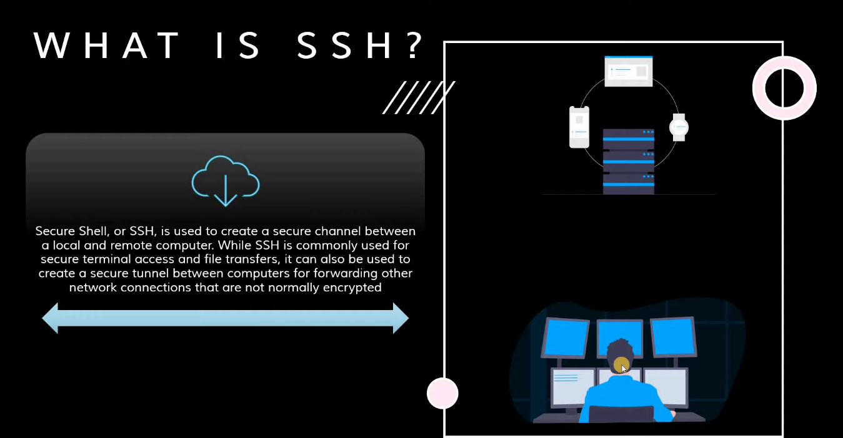

Slide 8
SSH Keys Configuration
you can connect and authenticate to remote servers and services. With SSH keys, you can connect to GitHub without supplying your username and personal access token at each visit
You can access and write data in repositories on GitHub.com using SSH (Secure Shell Protocol). When you connect via SSH, you authenticate using a private key file on your local machine.
When you set up SSH, you will need to generate a new private SSH key and add it to the SSH agent. You must also add the public SSH key to your account on GitHub before you use the key to authenticate or sign commits.

Slide 9
Checking for existing SSH keys
Before you generate an SSH key, you can check to see if you have any existing SSH keys.
ls ~/.ssh
$ ssh-keygen -t rsa -b4096 -C “ashishpoudel523@gmail.com”
RSA is a public-key. The acronym "RSA" comes from the surnames of Ron Rivest, Adi Shamir and Leonard Adleman, who publicly described the algorithm in 1977.
$ eval $(ssh-agent -s) $ ssh-add ~/.ssh/id_rsa
$ cat ~/.ssh/id_rsa $ cat ~/.ssh/id_rsa.pub
Testing your SSH connection
After you've set up your SSH key and added it to your account on GitHub.com, you can test your connection.
$ ssh -T git@github.com
# Attempts to ssh to GitHub

Slide 10
How to Add a New Remote to your Git Repo?
use the git remote add command on the terminal, in the directory your repository is stored at.
The git remote add command takes two arguments:
A unique remote name, for example, “my_repo”
A remote URL, which you can find on the Source sub-tab of your Git repo

Slide 11
Connecting git with Github
• From your project directory, run `git init` to initialize
a git repository.
• Go to Github, and create a new repository with the name of your project.
Please Note: you must have files in your project directory to commit in order to push anything to your remote server.

Slide 12
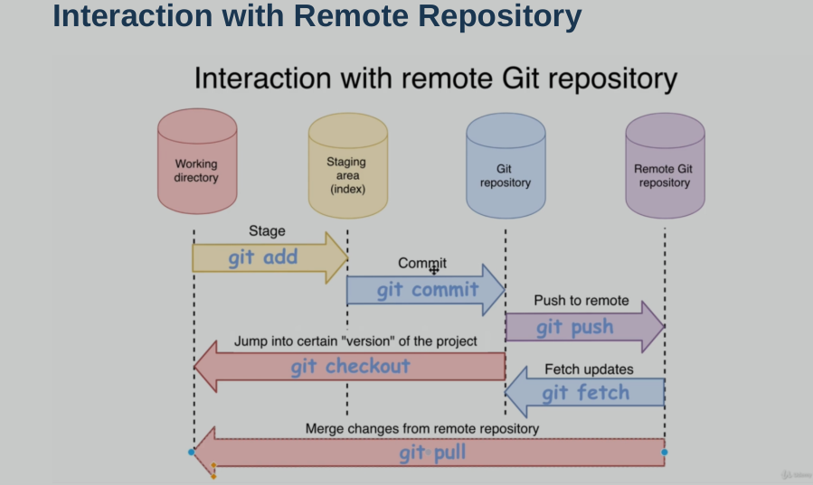

Slide 13
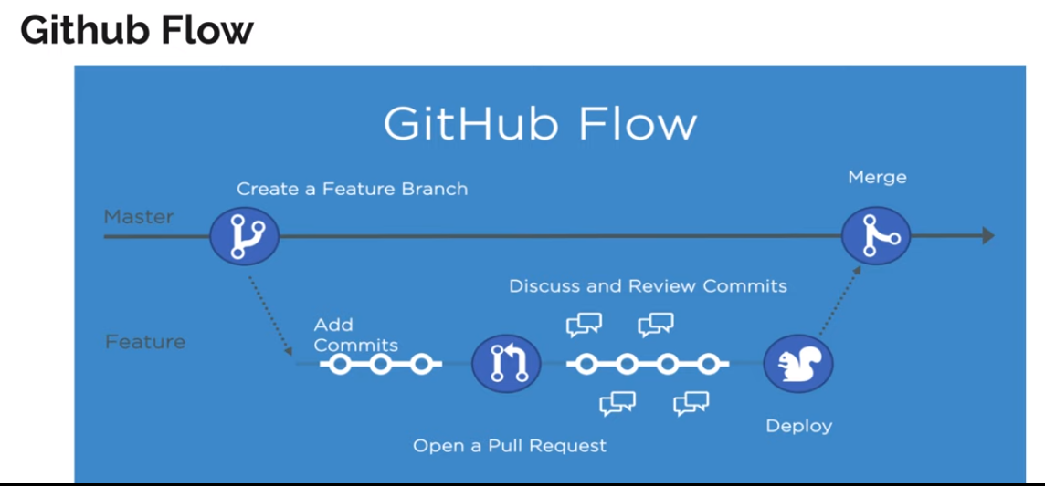

Slide 14
Working with remote repository
git clone <URL> clones the remote repository to the pwd on the disk.
git remote shows the list of remote
git branch -r , list of remote branches.
git branch –a, list of all local and remote branches

Slide 15
GitHub Flow
Create a branch with collaborators
Make changes
Create a pull request
Merge your pull request
Delete your branch

Slide 16
Cloning an existing repository:
git clone
git clone <repo url> //in HTTPS & SSH ways
An example Git SSH URL would be:
git@bitbucket.org:rhyolight/javascript-data-store.git
where the template values match:
HOSTNAME: bitbucket.org
USERNAME: rhyolight
REPONAME: javascript-data-store

Slide 17
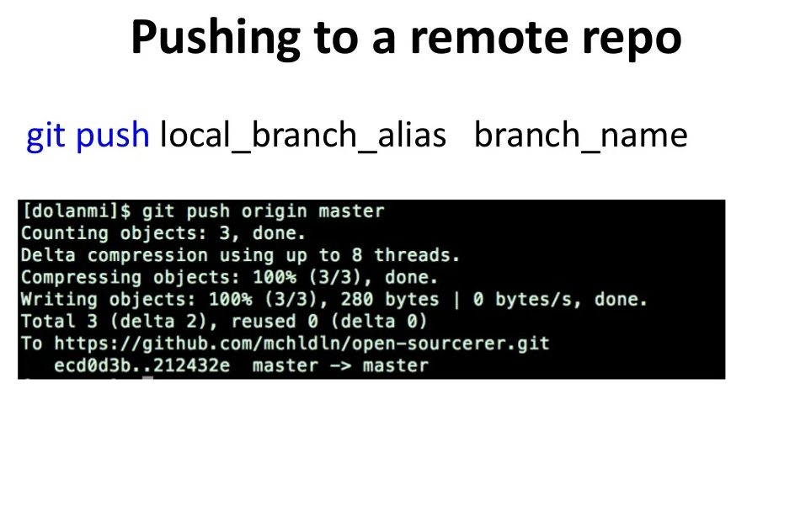

Slide 18
Contributing to a Project
Now that our account is set up, let’s walk through some details that
could be useful in helping you contribute to an existing project.
Forking Projects
Cloning others repo and pushing creates 403 unauthorized
response code.
So, fork the repo and pull request.

Slide 19
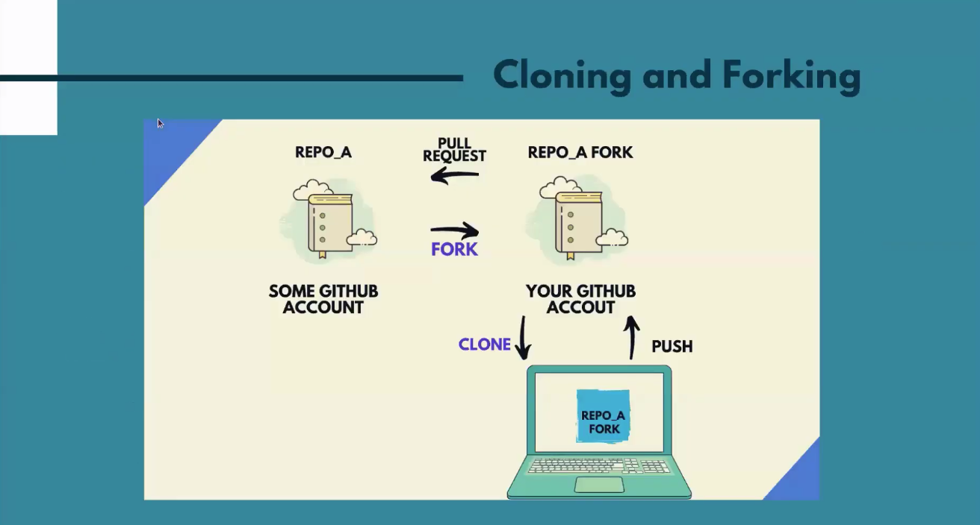

Slide 20
git remote -v shows the output of the list of remote servers.
$ git remote -v
origin git@github.com:ashishpoudel523/blog.git (fetch)
origin git@github.com:ashishpoudel523/blog.git (push)
git remote add upstream https://github.com/nepalkhabar/blog.git
upstream https://github.com/nepalkhabar/blog (fetch)
upstream https://github.com/nepalkhabar/blog (push)
git pull upstream main to pull all changes in main branch
$ git push origin branch1

Slide 21
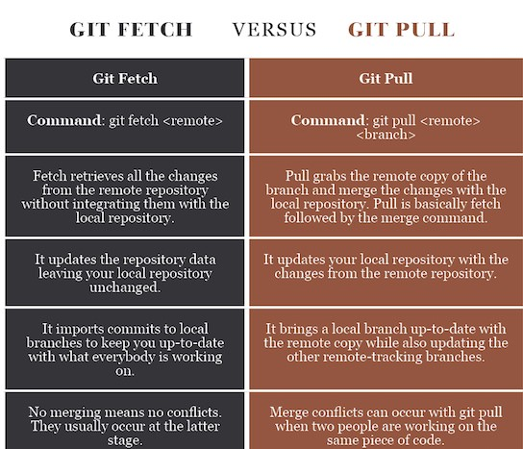

Slide 22
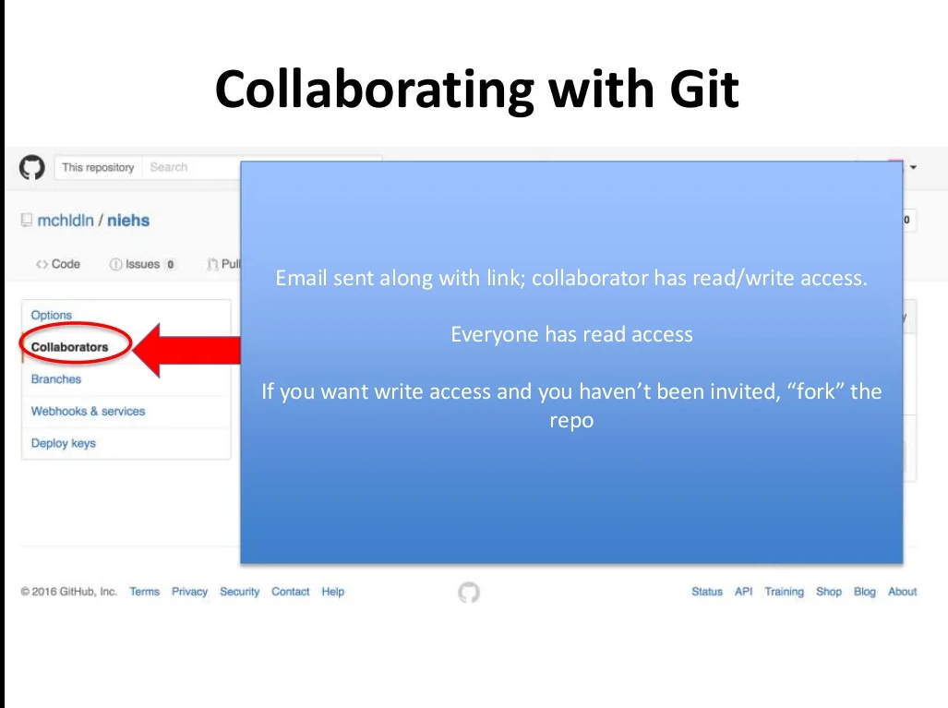
Private repo

Slide 23
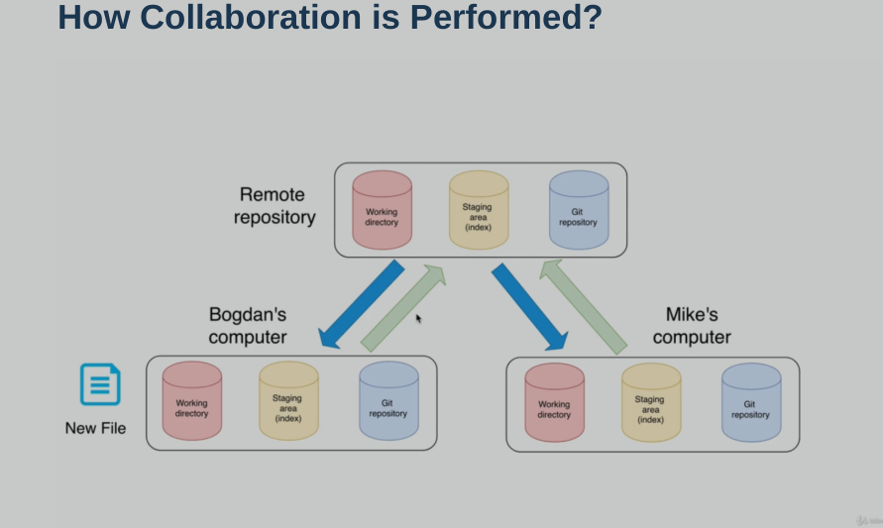

Slide 24
Creating Issues & Pull Request
Issues let you track your work on GitHub, where development happens.
When you mention an issue in another issue or pull request, the issue’s
timeline reflects the cross-reference so that you can keep track of related work.
Pull command is the most important command in GitHub. It tell the changes
done in the file and request other contributors to view it as well as merge it
with the master branch.
Merge Command = command which merge the changes into the
main master branch

Slide 25
Deleting Local and Remote Branches
Local delete = git branch -d local_branch_name
Force delete = git branch -D local_branch_name
Remote delete = git push origin -d remote_branch

Slide 26
GitHub Ninja Features
Markdown pages
Collaborative coding
Automation and CI/CD
GitHub pages
Gist
Project Management

Slide 27
SourceTree
A free Git client for Windows and Mac
Sourcetree simplifies how you interact with your Git repositories so you can focus on coding. Visualize and manage your repositories through Sourcetree's simple Git GUI.
Agenda:
Add Existing Project
Create Repository
Add Remote
Pull
Branch & Push
Merge & Delete Branch
Final Push
Clone Repo

Slide 28
THANK YOU ! ANY QUERIES?

